Slide 1
Android
Apps for the model car

Slide 2
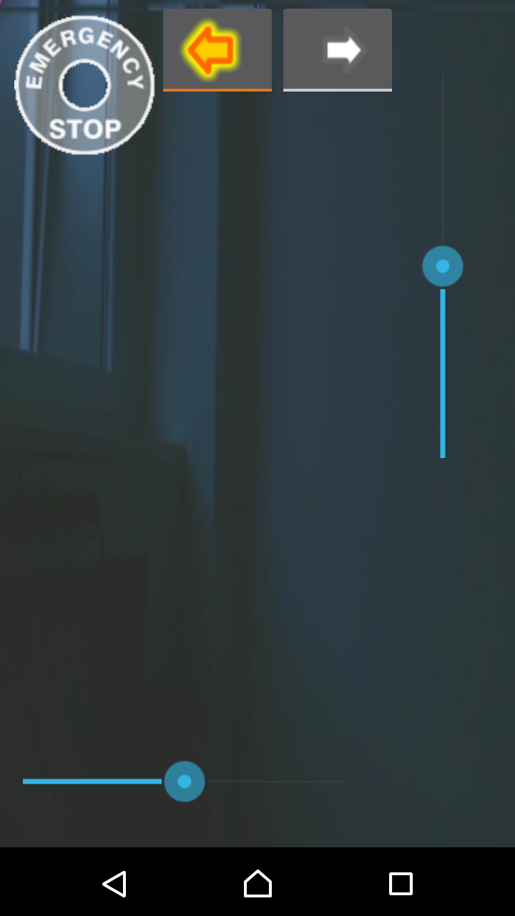
Car Control
control steering & velocity by a slider
emergency stop (disabled when gray)
left & right blinker
shows live images of model car’s front camera

Slide 3
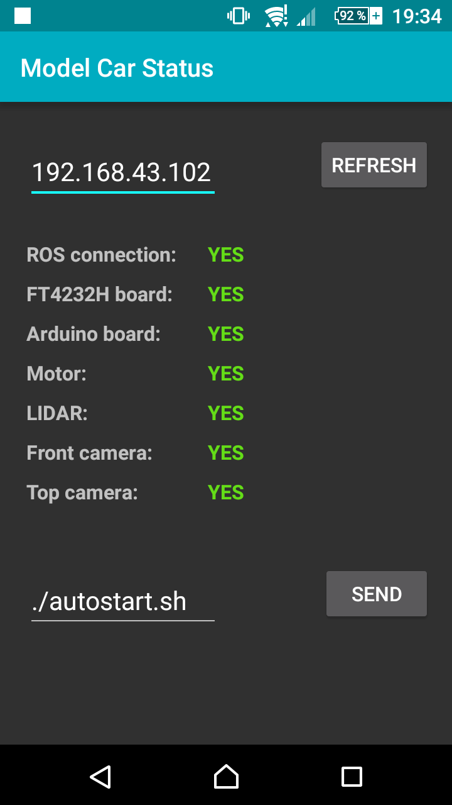
Car Status
checks connection from odroid to devices periodically
can start a program / script remotely (default autostart.sh)

Slide 4
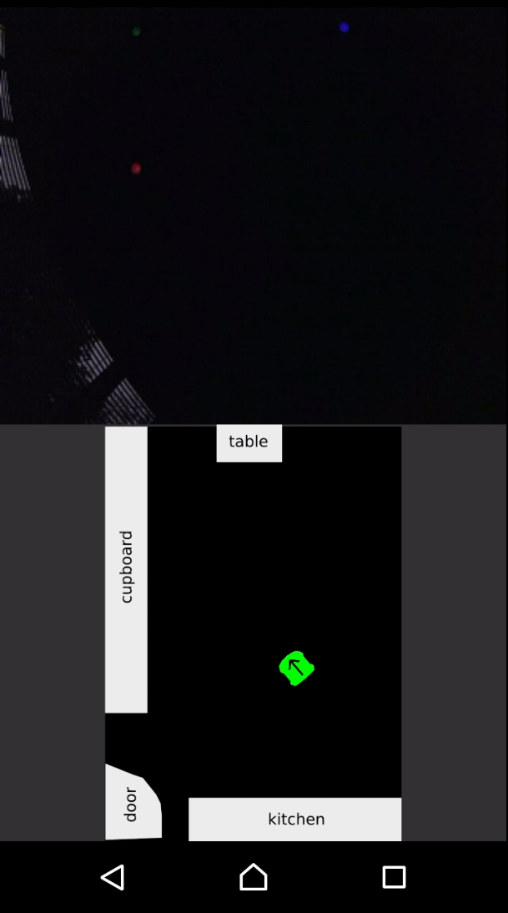
Car Localization
position of the model car on a map (provided by our visual_gps module)
live images of model car’s top camera

Slide 5
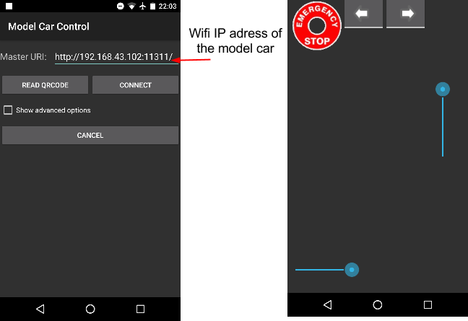
ROS Connection

Slide 6
Setup
install Android Studio:
https://developer.android.com/studio/index.html
install java jdk and rosjava dependencies:
$ sudo apt-get install openjdk-7-jdk ros-indigo-rosjava
clone the apps and open them in Android Studio:
https://github.com/AutoModelCar/android_app

Slide 7

Exercise
write an app that visualizes LIDAR data as occupancy grid
https://github.com/neumann89/car_lidar_grid_app

